Slide 1
Cube Interconnection Networks

Slide 2
Cube Interconnection Networks
Recirculating network or multistage network
Each vertex represents a PE
Vertical lines connect the vertices PE, whose address differ in MSB, most significant(left most).
Eg: 010 000
110 100
Horizontal lines differ in the LSB, least significant
Eg : 010 100
011 101
Vertices at both ends of the diagonal lines differ in the middle bit position
Eg : 000 001
010 011
In the ‘n’ cube, each PE located at a corner is directly connected to n neighbors.

Slide 3
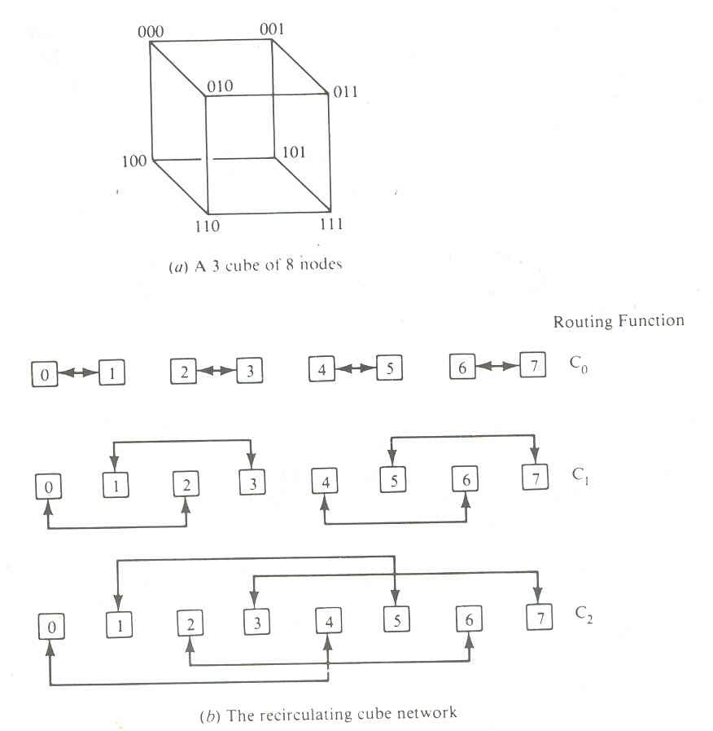

Slide 4
Implementation of a single stage cube network

Slide 5
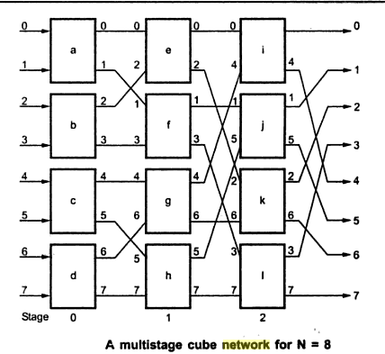
The same set of cube routing functions ^{C}₀ ^{,C}₁ ^{,C}₂ can also be implemented by a three stage cube network as modeled in Figure, for N=8.

Slide 6
Two-function switch boxes are used in constructing multistage cube n/w’s
Straight & exchange
Stage i implements the routing function Ci for i = 0, 1, 2… n-1 ( stage 0 implements C_{0,} stage 1-> C₁ etc)
This means that switch boxes at stage i connect an i/p line to the o/p line that differs from it only at the i^{th} bit position
Routing function C₂ executed on a 3-cube n/w corresponds to the permutation
P₂ = (0, 4) (1, 5) (2, 6) (3, 7)
If PE₂ & PE₆ become inactive by masking, cycle (2, 6) are removed and C₂ performs only the partial permutation

